Slide 1


An implementation of a true random number generator
Authors:
Std. Cap. Codreanu Andrei-Daniel
Std. Cap. Ivan Florentin-Marian
Coord.: Cpt. Eng. Iulian Aciobăniței

Slide 2
Table of contents
Random numbers in Cryptography
Difference between a TRNG & PRNG
Our implementation
Test Results
Security comparison to C’s default PRNG

Slide 3
1. Random numbers in cryptography
a software algorithm or hardware device that generates a number and outputs it;
generating a random set of data that can’t be reproduced can be challenging;
processes like key generation, initialization vectors and other cryptographic purposes.

Slide 4
2. Difference between a trng & prng
When talking about RNGs, in Cryptography there are two categories: True Random Number Generators (TRNGs) and Pseudo Random Number Generators (PRNGs). The key differences are:
TRNG
Generates unpredictable sets of data.
It exploits physical phenomena as a source of randomness (e.g. atmospheric noise, radioactive decay, etc.)
Under the same conditions, it will always produce a different output
PRNG
Uses deterministic algorithms (e.g. Mersenne Twister
If the seed is known, it produces predictable output
Given the same seed, a PRNG will produce identical sequences of values

Slide 5


3. Our implementation
We have chosen two high entropy sources (entropy = amount of unpredictable randomness):
Pictures of the sun in different spectral filters, taken by the Solar and Heliospheric Observatory (SOHO), which are being uploaded every 15 or so minutes.
Radio channels data from different radios around the world.
After extracting strings of raw data from each source, we perform a series of operations on them, including hashing using the Bernstein algorithm and SHA3-512 hashing algorithm.

Slide 6
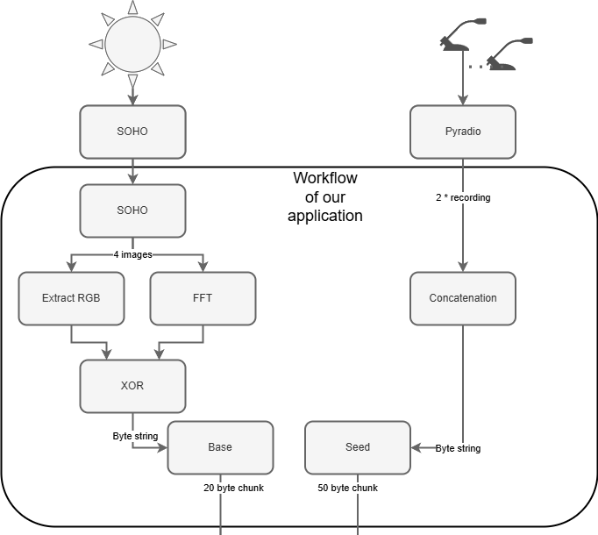
Application
workflow

Slide 7
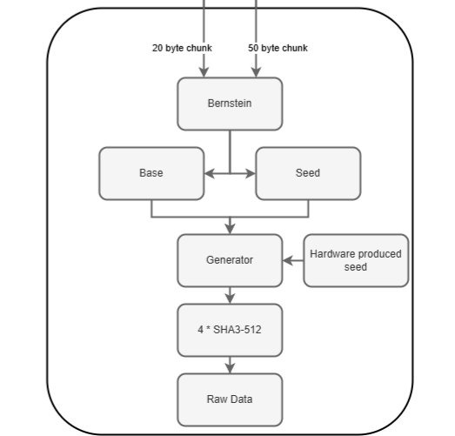
Application workflow

Slide 8
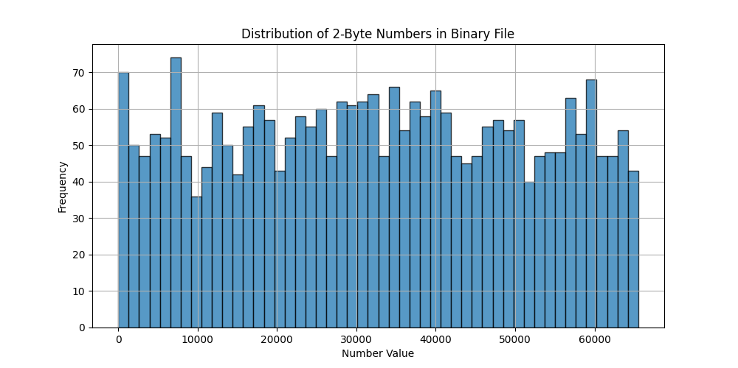
Boring math stuff
First try
4. Test results

Slide 9
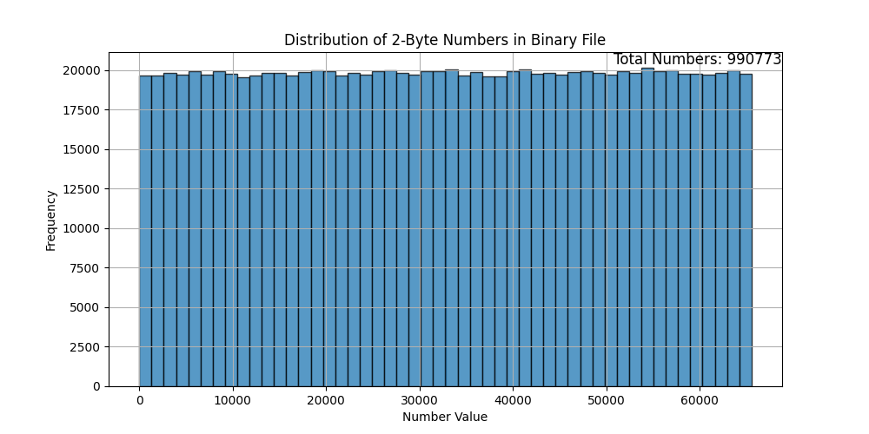
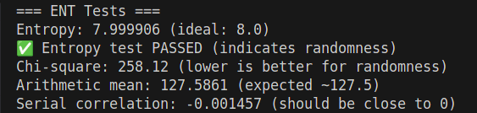
Boring math stuff
After applying DSA knowledge (Bernstein’s hash algorithm)
4. Test results
Chi-Square – tests the observer frequency of generated data
Arithmetic mean – tests if the data is centered around the expected average
Serial correlation – checks if a value is correlated with the following ones

Slide 10
NIST Test Suite report
------------------------------------------------------------------------------
RESULTS FOR THE UNIFORMITY OF P-VALUES AND THE PROPORTION OF PASSING SEQUENCES
------------------------------------------------------------------------------
generator is <data.bin>
------------------------------------------------------------------------------
C1 C2 C3 C4 C5 C6 C7 C8 C9 C10 P-VALUE PROPORTION STATISTICAL TEST
------------------------------------------------------------------------------
0 4 1 1 0 0 0 1 1 2 0.122325 10/10 Frequency
2 1 1 1 0 2 0 0 2 1 0.739918 10/10 BlockFrequency
2 0 5 0 0 0 2 0 0 1 0.004301 10/10 CumulativeSums
0 2 2 1 2 0 0 1 1 1 0.739918 10/10 CumulativeSums
1 2 0 0 2 0 2 1 0 2 0.534146 9/10 Runs
2 1 3 2 0 0 0 2 0 0 0.213309 9/10 LongestRun
2 0 1 2 2 0 1 1 0 1 0.739918 10/10 Rank
0 1 1 1 3 2 0 0 1 1 0.534146 10/10 FFT
1 2 1 0 1 1 0 1 3 0 0.534146 10/10 NonOverlappingTemplate
1 0 5 0 0 0 1 1 1 1 0.017912 10/10 NonOverlappingTemplate
1 0 2 1 0 0 1 1 1 3 0.534146 9/10 NonOverlappingTemplate
1 1 0 2 0 0 0 6 0 0 0.000199 10/10 NonOverlappingTemplate
1 0 2 1 1 1 1 0 1 2 0.911413 10/10 NonOverlappingTemplate
0 1 1 3 2 0 0 2 0 1 0.350485 10/10 NonOverlappingTemplate
1 0 0 0 0 3 5 1 0 0 0.002043 10/10 NonOverlappingTemplate
2 2 0 1 1 1 1 1 0 1 0.911413 10/10 NonOverlappingTemplate
2 0 0 0 5 0 0 3 0 0 0.000954 10/10 NonOverlappingTemplate
2 1 2 1 0 1 0 2 0 1 0.739918 10/10 NonOverlappingTemplate
Boring math stuff
4. Test results
To see the full report generated by the NIST test suite, please check the GitHub public repository provided at the end of this presentation.

Slide 11


Key aspect for comparison: the purpose we use it for!
PRNGs produce data really fast, but they have security flaws; good for every-day use
TRNGs are slower, but they produce irreproducible sets of data; good for cryptographic applications
4. Security comparison
to c’s prng
Let’s see a comparison using different tests between our TRNG and C’s standard RNG, which uses the Linear Congruential Generator.

Slide 12
Whilst both algorithms produce high entropy data, the main differences can be seen in their behavior when given the same start conditions.
4. Security comparison
to c’s prng
TRNG Comparison:
Hamming Distance: 1973795 / 1981546
Entropy File 1: 7.9999
Entropy File 2: 7.9999
Compression Ratio File 1: 1.0003
Compression Ratio File 2: 1.0003
Pearson Correlation: -0.0001
PRNG Comparison:
Hamming Distance: 0 / 1981546
Entropy File 1: 7.9999
Entropy File 2: 7.9999
Compression Ratio File 1: 1.0003
Compression Ratio File 2: 1.0003
Pearson Correlation: 1.0000
Some more math stuff
Hamming distance – the number of bit positions that differ in each file
Pearson Correlation – measures the linear relationship between two variables; as one increases, the other one increases too (+1) or as one increases, the other decreases (-1) or there is no linear relationship between the variables (0).

Slide 13

An implementation of a true random number generator
https://www.github.com/RexGloriae/RandomNumber

